Slide 1
Review of Security Foundations
What is information security about?
Details on slides 2-3
What are some terms that describe our concerns?
Details on slide 4
What are the goals and key concepts of information security?
Details on slides 5-10
Can we solve information security issues through better technology?
Details on slide 11

Slide 2

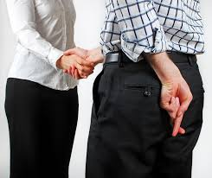
What is Information Security about?
Society is increasingly more reliant on computers
Placing trust on computer applications is a necessity
But are all computer systems trustworthy?
Trust is placing your confidence in something
Trustworthiness is placing confidence correctly
Trust is belief that a system will operate in an expected manner with attacks causing minimal damage to system and users
Trustworthy systems do operate in an expected manner and resist damage from attacks

Slide 3
What is Information Security about? (cont’d)
Information security studies ways to make systems trustworthy
By assuring a computer system will behave reasonably even in the face of malicious attacks
NIST Cybersecurity Framework
Lists five functions of information security
Identify (system vulnerabilities)
Protect (the system from attacks)
Detect (attacks on the system if they occur)
Respond (to attacks in a reasonable way)
Recover (from attacks to cause minimal damage)
Each function contains outcomes and describes use of standards, guidelines and practices

Slide 4
NIST Function #1: What to Identify?
Vulnerabilities
Weaknesses in system that expose it to an attack
e.g. using non validated external data allows SQL injection attacks
Threats or attackers
Adversaries who may exploit vulnerabilities
Includes unintentional blunders, hackers, disgruntled employees, organized crime, market competitors, foreign nations
Potential threats vary based on given system.
e.g., student record system is unlikely to be targeted by a foreign nation or organized crime
Risk
The expected damage from a security violation.
Includes likelihood of a vulnerability being exploited and cost of damage
e.g. web service may have vulnerability, but if it’s not connected to network, risk is zero
Attack vectors
Describes how attacker could carry out an attack
e.g., malicious email attachment, SQL code injection, tricking human operator

Slide 5
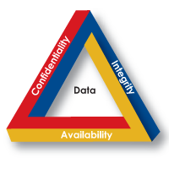
Goals of Security
C.I.A = Confidentiality, Integrity, Availability
Integrity
assurance that data has not been altered in an unauthorized way
Confidentiality protect data from unauthorized disclosure
Availability
assurance that the data/service is accessible to those with access to it

Slide 6
Breaches of C.I.A
Confidentiality Breach
Sensitive information reaches unauthorized persons
A student finds a file with test scores of all students in a class
A student’s private discussions with counselor is revealed to an instructor
A student’s records are released without obtaining student’s permission
Integrity Breach
Data is fraudulent or altered without authority
An email that looks like it is from your bank but in fact is a phishing attack
A request to transfer $100 from account is changed by attacker to $10,000
Breaches of availability
Losing access to services
Not being able to access a web site if it is under a denial of service attack
A malicious attacker changes passwords of valid users, preventing them from accessing the service/site

Slide 7
Balancing C.I.A
C.I.A goals are at odds with one another and must be balanced
Increasing availability usually decreases confidentiality and integrity
Example 1
Lockout a user’s account after several failed password attempts
Policy compromises availability for confidentiality and data integrity
Suitable for some settings (e.g., email, bank accounts)
Not for others (e.g., medical records, military systems)
Example 2
Allow users to do queries over a population (e.g. find average salary of Le Moyne Employees)
For integrity query results should be accurate
But queries over a small population can reveal salary of one person
Note: gender, date of birth, and zip code (i.e., well known attributes for an individual) together uniquely identify 99% of the people in Cambridge, Massachusetts

Slide 8
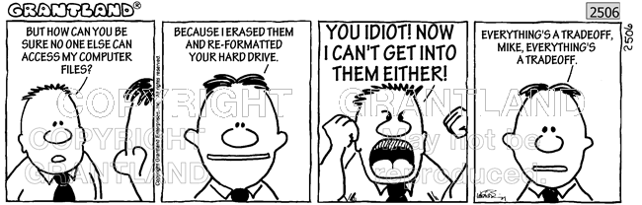
Perfect Security
Since C.I.A goals are often at odds it is impossible to design systems with perfect security
Our goal is to minimize risk and to be aware (as much as is possible) of the risks that remain

Slide 9
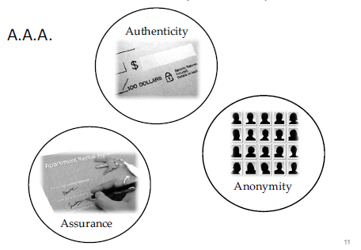
A.A.A – Security Concepts for trust
Authenticity
ability to determine that statements, policies, and permissions are genuine
e.g. ATM card and a pin authenticates that you have right to make a withdrawal from your account
Assurance
how trust is managed
Policies (i.e., behavioral expectations)
Permissions (i.e., behaviors allowed by agents)
Protections (i.e., mechanisms to enforce policies and permissions)
Anonymity
not possible to attribute certain records or transactions to any individual

Slide 10
How to Authenticate?
Authenticate
Determine if statements, policies, and permissions are genuine
Authentication can be done based on
Something you know
e.g., PIN, a password, or mother's maiden name
Something you have
e.g., a driver's license, magnetic swipe card, car keys
Something you are
e.g., biometrics, e.g. fingerprints, retina scans, etc.

Slide 11
Cybersecurity is an Inter-disciplinary
Information security requires more than just technical solutions
e.g., can technology alone solve social engineering attacks?
Spoofing someone’s email address (phishing attacks)
Spoofing a bank’s web-site
Cybersecurity programs must also address
Policy choices
How quickly do we respond to a known vulnerability?
What data do we persistently store? Why? How? Duration?
How do we support attribution?
Ethical issues
Who should be notified of a data breach? How quickly?

